Slide 1


RESULT LUNIT TEST [Lunit] 암 조직 슬라이드 이미지 수집 및 분석 서버 구현
조민수

Slide 2
Contents
Structure
DB ERD
API Specification
Result
Truble Shooting
Test Flow
Takeaway

Slide 3
Structure

Slide 4
DB ERD

Slide 5
API Specification
Account
METHOD | URI | Description
POST | /login | Login and Session issuance

Slide 6
API Specification
Slide
METHOD | URI [ api/slides ] | Description
GET | / | Downloadable slide list
GET | /{search} | Search filename by search word
GET | /download/{slideId} | Download silde
POST | / | Upload slide on server storage

Slide 7
API Specification
History
METHOD | URI [ api/histories ] | Description
GET | / | Return your analysis history list
GET | /{historyId} | Return history
GET | /analysis/{slideId} | Analysis slide and return result

Slide 8
Result
Essential Requirements
Optional Requirements

Slide 9
Essential Requirements
Login and Authentication
Slide img up/download
Find all slide only you uploaded, search by file name
Require slide analysis and immediately receive result
Whenever you can find your analysis history
Using docker-compose, you can publish development environment

Slide 10
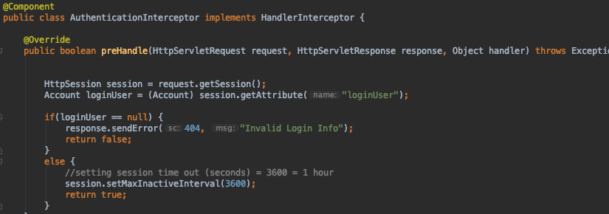
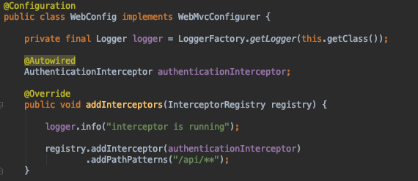
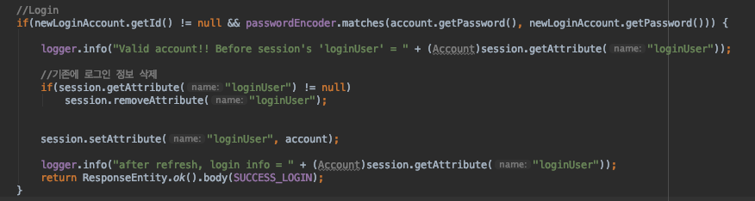
Essential Requirements
Login and Authentication
WebConfig
Interceptor
/login

Slide 11
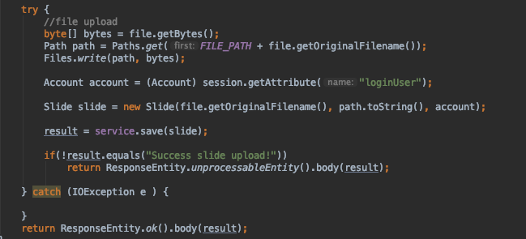
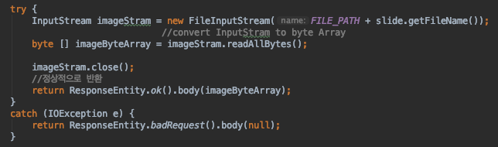
Essential Requirements
Slide img up/download
Slide Upload
Slide Download

Slide 12
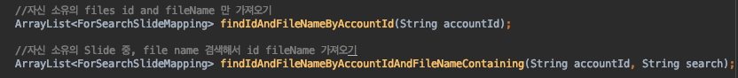
Essential Requirements
Find all slide only you uploaded, search by file name
SlideRepository

Slide 13
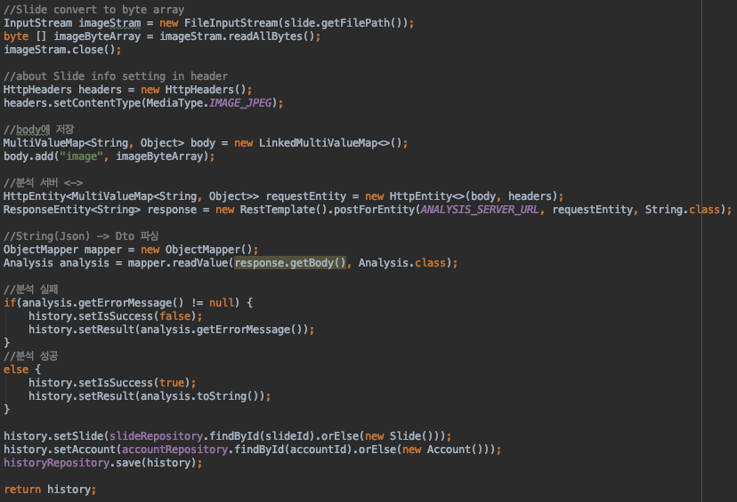
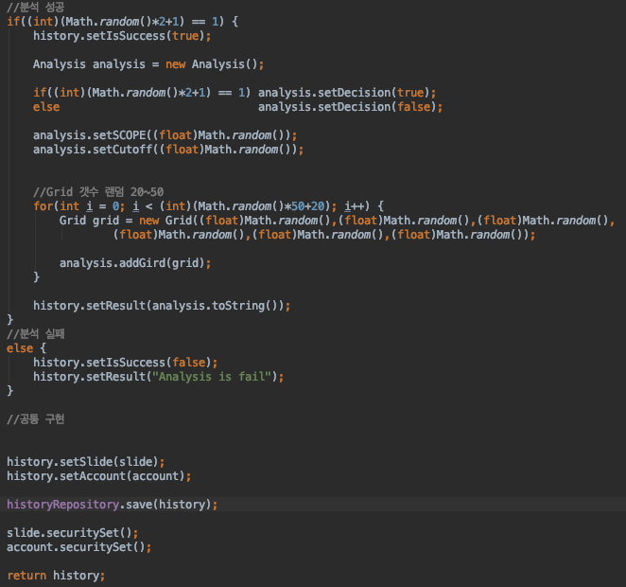
Essential Requirements
Require slide analysis and immediately receive result
Dummy making
Request analysis
Logic

Slide 14
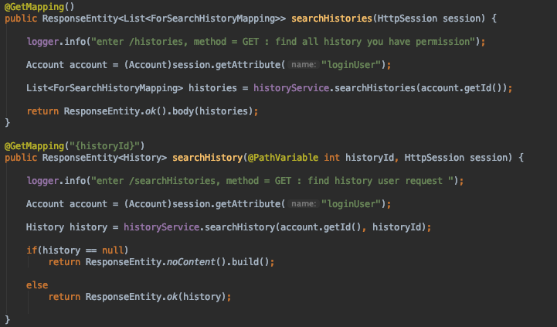
Essential Requirements
Whenever you can find your analysis history
HistoryController

Slide 15
Optional Requirements
Oauth 2.0
Divide ‘authentication server’ and ‘API server’
Consider slide img’s size is bigger than 2GB
Consider slide analysis take more than 10 minutes
Good if you have test code

Slide 16
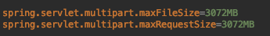
Essential Requirements
Consider slide img’s size is bigger than 2GB

Slide 17
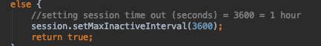
Essential Requirements
Consider slide analysis take more than 10 minutes

Slide 18

Truble Shooting
When convert String(Json) to Dto, Boolean value doesn’t convert

Slide 19
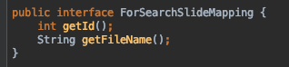
Takeaway
The importance of design
The importance of pagination
Simplify data

Slide 20
Thank you for the opportunity to test

